Slide 1
Thorny Issues
Special Benefits
Existing Right of Way
Proximity
Notes:
Comments to Chuck
Talking on Thorny Issues – covering topics that can catch us off guard because of their infrequency or need to for greater attention to detail

Slide 2
Special Benefits
1. Differ in Kind, not Degree
  The benefit needs to be unique in kind to an individual property on the project.
  2. Special Benefit relates to property value (real estate), not business value

Slide 3
Special Benefits
3. Is the Highest and Best use favorably changed or is the current use made more adaptable.
a. Will zoning or community planning accommodate more favorable use?
b. What has the project done for the owner that they could not have done for themself?
Notes:
H/B use change – could be the ability to subdivide residential lots previously undividable, conversion to commercial use from alternative use
More adaptable use – an existing development becomes more developable

Slide 4
Special Benefits
“While the burden of proof as to damages in eminent domain rests upon the landowner, the existence of special benefits is a matter of affirmative defense as to which the burden is upon the condemnor, and it must show that the claimed special benefits are direct, immediate, and certain, both as to time and place, not remote or speculative.”
Hietpas vs. State, 24 Wis (2d) 650
Notes:
Supreme Court indicated in Hietpas the following:
In other words, is the special benefit imminent and predictable.
Which leads us to the question of: are we looking at these issues as though the information we are considering is an extraordinary assumption, or a hypothetical condition.

Slide 5
Extraordinary Assumption
Extra Ordinary Assumption - An assumption directly related to a specific assignment, which, if found to be false, could alter the appraiser’s opinions or conclusions. Extraordinary assumptions presume as fact otherwise uncertain information about physical, legal, or economic characteristics of the subject property, conditions external to the property, such as market conditions or trends, or about the integrity of data used in an analysis.
Notes:
As appraisers, the information we gather in the process of analyzing a property falls in to one of two categories for us.
Extra ordinary assumption
Hypothetical condition

Slide 6
Hypothetical Condition
Hypothetical Condition – That which is contrary to what exists but is supposed for the purpose of analysis. Hypothetical conditions assume conditions contrary to known facts about physical, legal or economic characteristics of the subject property; or about conditions external to the property, such as market conditions or trends, or about the integrity of data used in the analysis.

Slide 7
Existing Right of Way
Chapter 82 – Wisconsin Statutes
Typical highway is 66’ wide or 4 rods
Rod = 16.5’
Highways can be recorded, unrecorded, laid out, or created by user. In the case of Affeldt, when (date of resolution) the highway was resolved to be used can become a factor.
Notes:
Find this to be a unique issue, because only in eminent domain are we routinely asked as appraisers, by a condemning client, to value a property, based on an extra ordinary assumption, not a hypothetical condition, that the property’s net size (absent existing right of way) is . . . .
I am not questioning the legitimacy of a 66’ wide right of way in most cases, but there are clearly cases in which the presence of fences, landscaping, even buildings in the right of way, have been enough to warrant the necessity of compensation when removed by a municipality. And when the right of way extends beyond a statutory 66’ width, what are the supporting documents that lead to that conclusion.

Slide 8
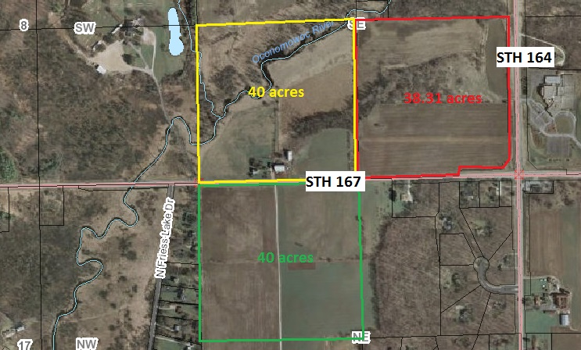
Existing Right of Way
Notes:
The presence of existing right of way and deduction of land occupied by existing highway improvements, from the overall parcel size is unique to eminent domain. (38.31 acres)
I can only imagine the storm of responses that would arise from clients and users of our reports in incidents outside of eminent domain if we routinely began reducing parcel size for value due to our estimate of existing right of way. I say that because, in everyday real estate transactions, market participants buy and sell real estate based on a gross parcel size, determined by tax/assessment record or survey.
Understandably, condemning clients don’t want to pay compensation for land they perceive to already be there’s by rights of their ongoing improvement and maintenance through the years.
I am not here today to soap box about whether or not existing right of way should be compensated, it is understandable why a municipality feels strongly about not paying for land they have maintained. Similarly, it is understandable why landowners (particularly if they have just purchased the land within the past couple of years) have strong feelings about just turning over existing right of way they paid for in a recent purchase.

Slide 9
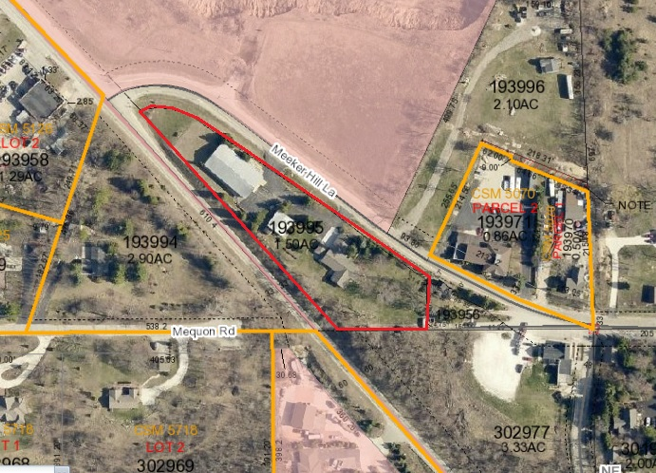
Existing Right of Way

Slide 10
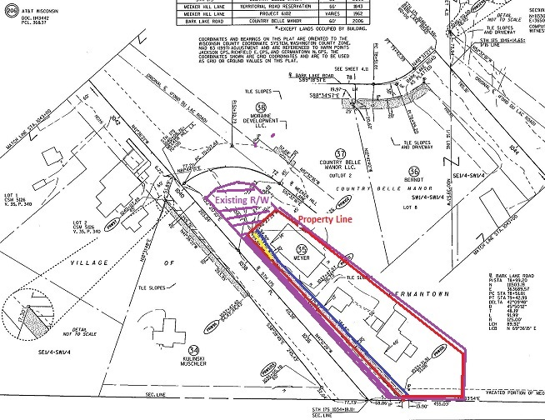
Existing Right of Way
Notes:
Survey stakes
GIS map
Earlier project from 1924
Easement documents - 1963

Slide 11
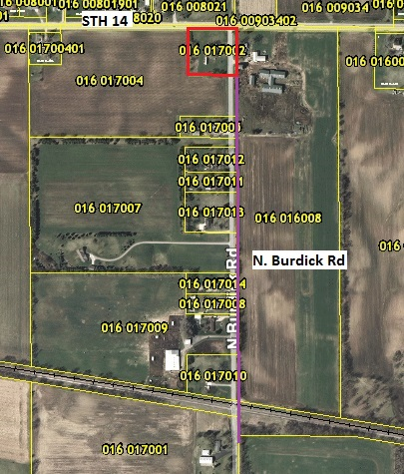
Existing Right of Way

Slide 12
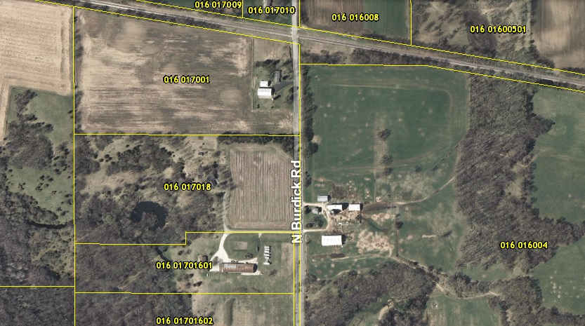
Existing Right of Way

Slide 13
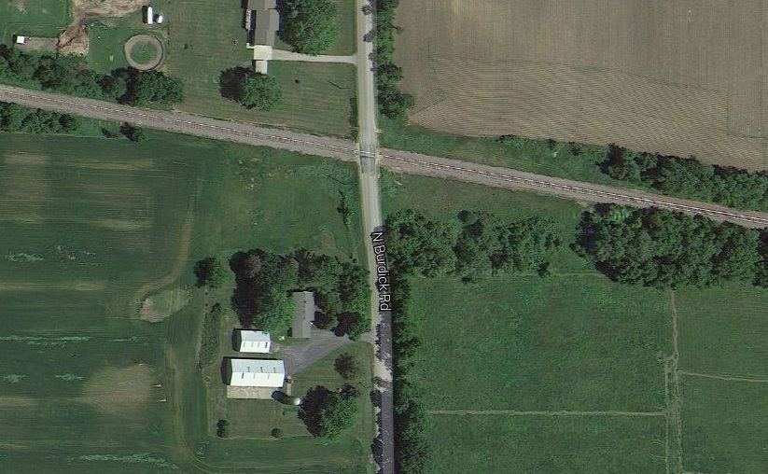
Existing Right of Way
Notes:
Is the road laid out and recorded or unrecorded to run along the section line?
Would a court uphold the way the road was recorded (if it was) rather than the way it might have been constructed?
Given that a town road might only be paved to a 20’ width, is it possible the road shift did not put the pavements beyond the owner’s 33’ of right of way on the west side of the section line?

Slide 14

Keep our eyes open

Slide 15

Don’t get bogged down in “routine”

Slide 16

Be alert for situations that may require extra effort

