Slide 1
The Appraiser as an Expert Witness An Appraiser’s Perspective
Needs for an Appraisal Expert
The Effective Expert
USPAP & the Appraiser Expert
The Deposition
The Trial

Slide 2
Needs for an Appraisal Expert in Litigation
Eminent domain
Tax appeal
Inverse condemnation
Partitionments
Bankruptcy
Construction defects
Contaminated properties
Gift tax
Trust and probate
Missed easements (title companies)
Insurance losses
Divorce

Slide 3
The Effective Expert What Makes a Good Expert?
Preparation
When to start?
Thorough, well documented analysis & report
Confidence
You wouldn’t be engaged as an expert if you did not know what you are doing
You know more about appraisal theory, the subject property, the market, your analyses and opinions than anyone else

Slide 4
The Effective Expert What Makes a Good Expert?
Ethical and professional
Ethics matter, Integrity matters
Objective, unbiased, honest
Advocate for your opinions, do not advocate your client’s interests
Ability to explain and defend your opinions
Think once, speak not at all; think twice, speak once
Stand your ground
Thick skinned

Slide 5
The Effective Expert What Makes a Good Expert?
Remember, attorneys you work for today may be the opposition tomorrow
Be familiar with the Jury Instructions

Slide 6
The Effective Expert What Makes a Good Expert?
Jury Instructions for Eminent Domain
WIS JI-CIVIL, 8100-8145

Slide 7
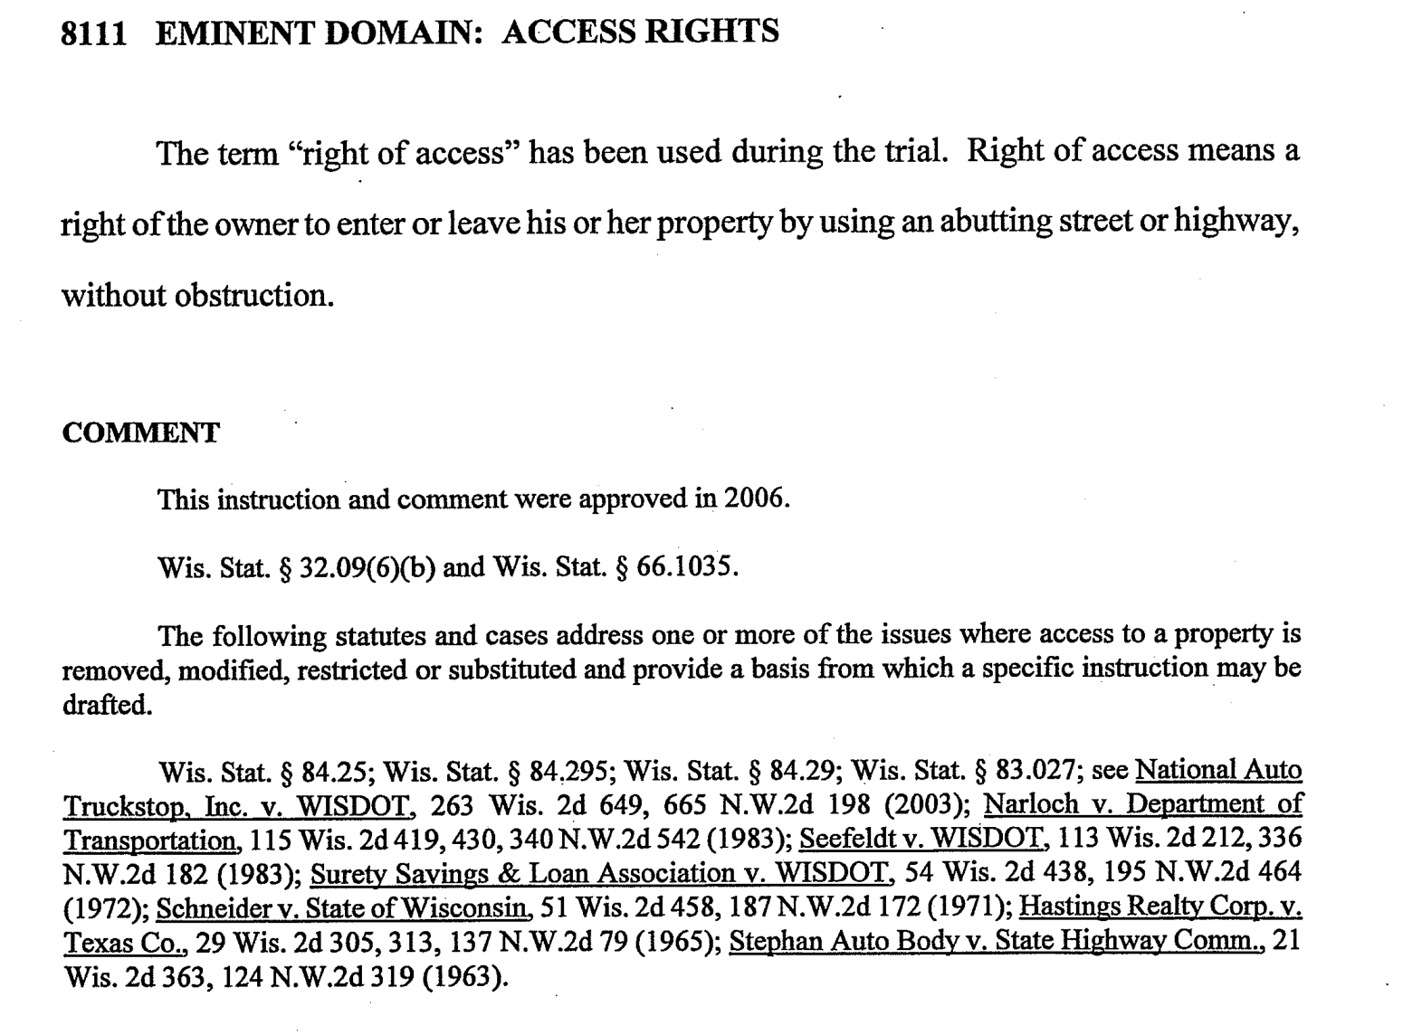
The Effective Expert What Makes a Good Expert?

Slide 8
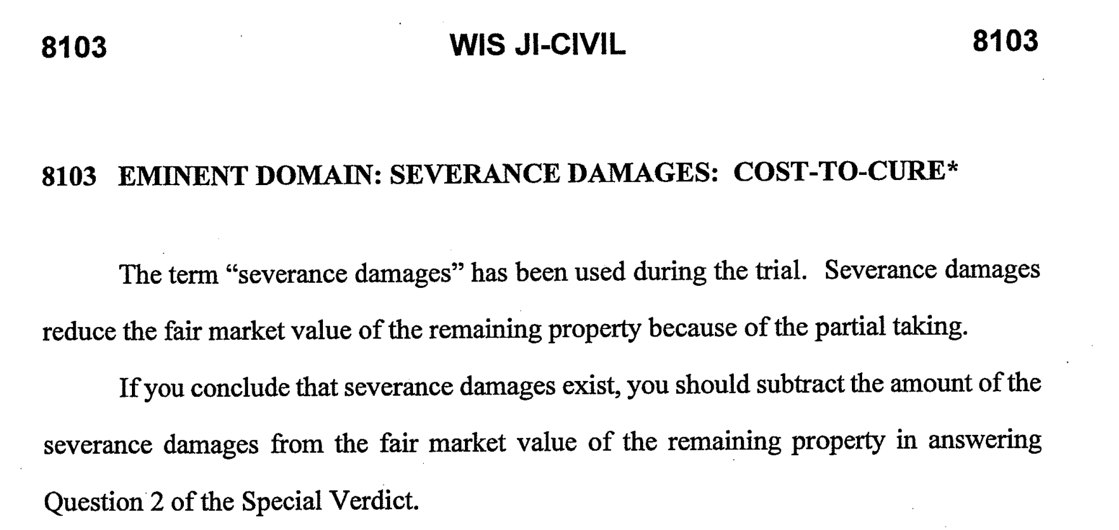
The Effective Expert What Makes a Good Expert?

Slide 9
USPAP & the Appraiser Expert
Which version of USPAP applies?
State Certification
Wisconsin is a non-mandatory appraiser license state
All appraisals performed in conjunction with federally related transactions and non-federally related transactions shall conform to the USPAP in effect at the time the appraisals are performed. SPS 86.01(2)
De Minimis rules apply for licensed and certified residential appraisers
$250,000 for commercial properties

Slide 10
USPAP & the Appraiser Expert
Ethics Rule
impartial, object and independent
Advocacy (USPAP Advisory Opinion 21, pg. A-64)
must not advocate the cause or interest of any party or issue
If acting as an appraiser, litigation services are part of the appraisal process and USPAP applies
If services include providing an opinion about the quality of another appraiser’s work, the appraisal review requirements of SR 3 apply

Slide 11
USPAP & the Appraiser Expert
Advocacy
If you provide litigation services as an advocate, then the valuation service is outside of appraisal practice
USPAP doesn’t apply except that you must not misrepresent your role
Key Point:
You may provide litigation services by either acting as an appraiser or as an advocate for the client’s cause;
however, the appraiser must not perform both roles in the same case (AO 21, pg. A-71)

Slide 12
USPAP & the Appraiser Expert
Record Keeping Rule
The workfile must include summaries of all oral reports or testimony, or a transcript of testimony, including the appraiser’s signed and dated certification
Competency Rule
Oral Report
SR 2-1, Real Property Appraisal Reporting

Slide 13
USPAP & the Appraiser Expert
Review Appraisal (USPAP SR-3)
Applies if commenting on the quality of appraisal reports
You are required to develop an opinion as to the:
Completeness, accuracy, adequacy, relevance and reasonableness of the analysis and report under review
Oral Review Report
SR 3-5, content of an Appraisal Review Report

Slide 14
USPAP & the Appraiser Expert
Relying on Work Done by Others
You are responsible for the decision to rely on work of others
You are required to have a reasonable basis for believing that the individuals are competent
You must have no reason to doubt that the work is credible

Slide 15
The Deposition
Primary reasons for a deposition
Allows the opposing attorney:
to understand your opinions
to review your work and examine you under oath
to get a sense of your ability as a witness
Demeanor, stress, criticism, argumentative
See how well prepared you are

Slide 16
The Deposition
Primary reasons for a deposition
Allows the opposing attorney:
to understand the strengths and weaknesses in your opinions and report
to see how well you defend the perceived weak points in your appraisal
try to generate responses that could be used to discredit your testimony at trial

Slide 17
The Deposition Do’s & Don’ts
Do
Be well prepared, organized and well rested
Answer the questions, don’t volunteer information
Keep your emotions in check
Know the weaknesses in your analysis and appraisal and be prepared to answer
Pause to allow your attorney to object
Keep within your defined box of expertise
Bring your calculator

Slide 18
The Deposition Do’s & Don’ts
Don’t
Say “I guess”
Be intimidated
Get caught in a trap with hypothetical questions
Don’t offer opinions of the other appraiser’s work unless you’ve completed a USPAP Standard 3 review
Point out the supported differences in your work or opinions versus the other appraiser’s
“Yes I considered that sale but disregarded it because …”

Slide 19
The Deposition Do’s & Don’ts
Typical question near the end:
Have you provided or explained everything you used to come to your opinions?
“Everything that I can think of at this time regarding the questions you have asked.”

Slide 20
The Trial
Plaintiff’s expert is first, defendant is second
Should you be in the courtroom during the other expert’s testimony?
Direct examination
Be prepared, well rested
Prepare brief summary of your qualifications
Need to spend time describing the property, market, neighborhood, H&BU, SCA, ICA, CA
Prepare brief summaries
Expect open ended questions

Slide 21
The Trial
Direct examination
Need to teach the jury and judge
Address the jury not the attorney
Watch the jurors for attentiveness and adjust your testimony as needed
Are they getting bored? Do they get it?
“Listen, this is an important point”

Slide 22
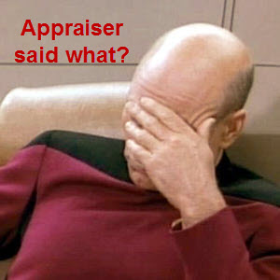
The Trial
Not a good sign

Slide 23
The Trial
Cross-Examination
Now the real “fun” starts
Bring organized worknotes
Bring The Appraisal of Real Estate to the stand
Bring your calculator
Be prepared for the tough questions
Will be questioned on your perceived weak areas
Know your deposition testimony

Slide 24
The Trial
Cross-Examination
Explain as much as allowed to
Yes and no answers
Pause for objections
Don’t caught up in winning the case
Advocate your opinions, not your client’s

Slide 25
The Trial
Be confident, professional and personable
You know more about appraisal and your appraisal than anyone else in the courtroom

Slide 26
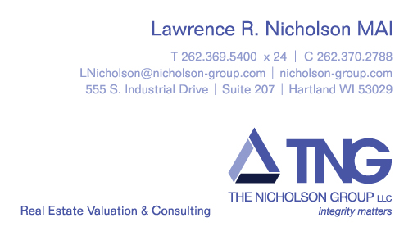
The Appraiser as an Expert Witness An Appraiser’s Perspective
Thank You

