Slide 1
Proximity
Prepared for the Appraisal Institute Symposium 6/3/2015
By Richard F. Dickson
Director of Real Estate Services
CORRE, Inc

Slide 2
Proximity
Definition: “an element of severance (compensable) damages that is caused by the remainder’s proximity to the improvement being constructed, e.g., a highway;….” The Dictionary of Real Estate Appraisal; 5th edition Appraisal Institute

Slide 3
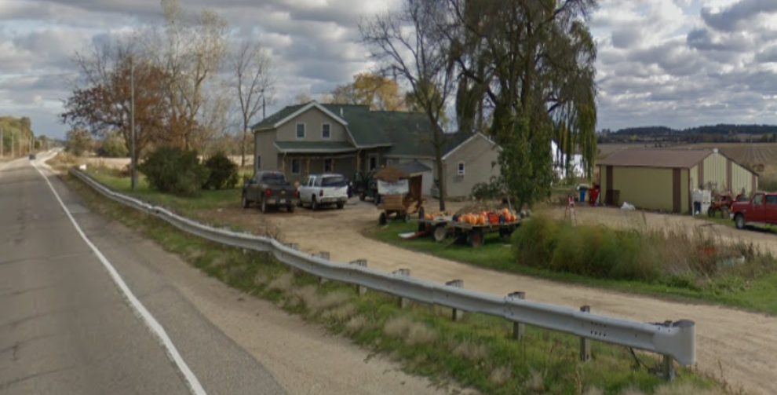
What do you mean proximity damages?

Slide 4
Historic Solutions to the Appraisal Problem
Proximity Studies: similar to landlocked studies
Difficulties: almost impossible to find recent sold properties that are similar enough to the subject in the after condition to use for direct comparison.

Slide 5
What about a change in the Market?
With a change in the neighborhood, you have a corresponding change in the market of the property.
A change in the market results in a change in the buyers that would be attracted to the property.
Perhaps the analysis of the “user market” (owners, occupants and competition) will lead to understanding the loss in value due to proximity.

Slide 6
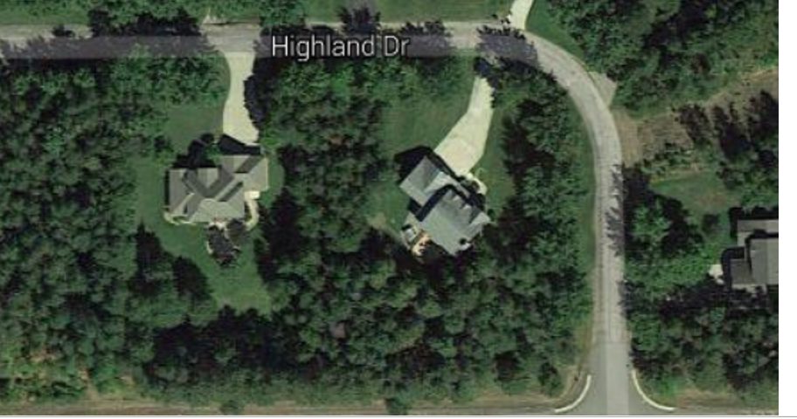
This Neighborhood

Slide 7
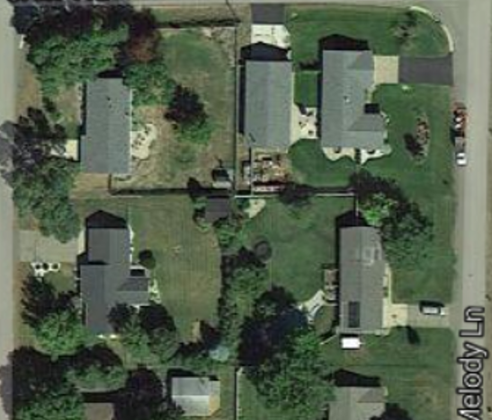
To This Neighborhood

Slide 8
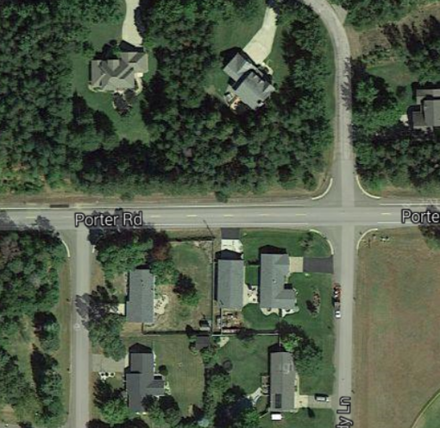
What if you took all the trees in the upper neighborhood?

Slide 9
Progression
Consider the concept that the value of an inferior property is enhanced by its association with better properties of the same type.
In accordance with the principle of progression, a low priced property will be worth more in a higher-priced neighborhood than it would be in a neighborhood of comparable properties.

Slide 10
Regression
Also consider the concept that the value of a superior property is adversely affected by its association with an inferior property of the same type.
Under the principle of regression, a higher-priced property will be worth less in a low-priced neighborhood than it would in a neighborhood of comparable properties.

Slide 11
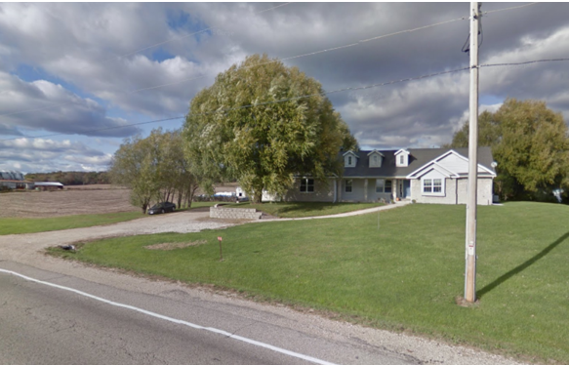
If you take the front yard off this home, have you put it into a different market?

Slide 12
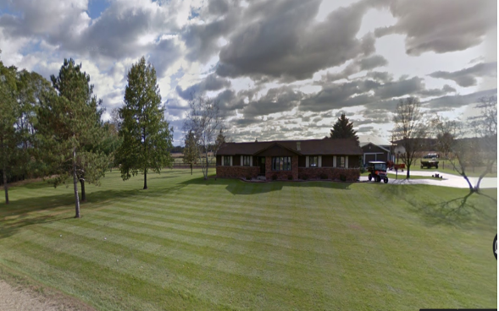
What type of market would this house fit in without the front yard?

Slide 13
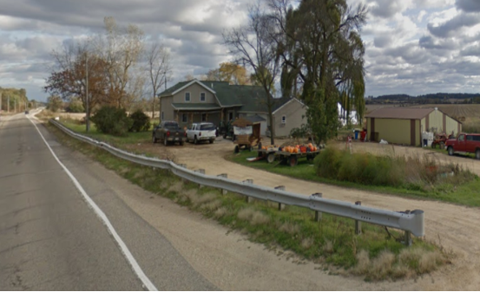
Does it revert to this market?

Slide 14
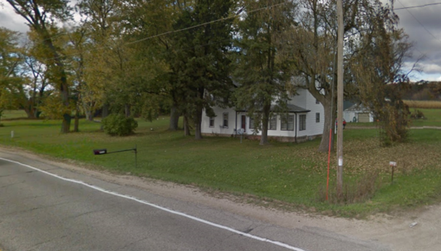
Or this?

Slide 15
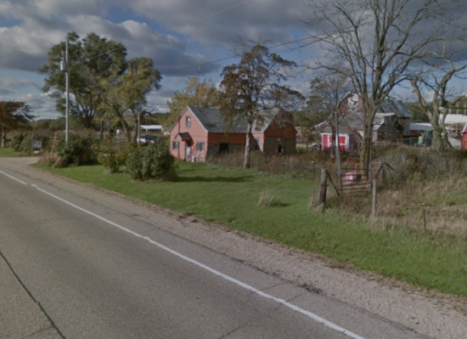
Or this?

Slide 16
How would you measure the Loss that results from the change in market?
Buyer base or Market is based on income levels, household size, age, and preferences. External obsolescence is caused by a deficiency: proximity. It is incurable. Similar to the proximity to a negative environmental factor.
Moderate-income and moderate density housing = Moderate-proximal housing (close set back from the highway, not as isolated, etc.)
Middle-income and low density housing = Higher extended-proximal housing (set back is greater than the moderate-proximal)
High-income and very low density housing = Very high-proximal housing
High-income residential improvements are rarely located in close proximity to highways.

Slide 17
Case For Analysis

Slide 18
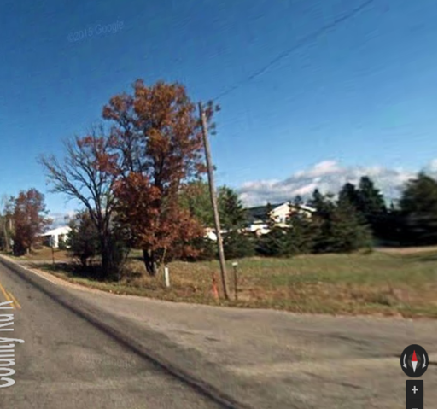
Subject Improved Property

Slide 19
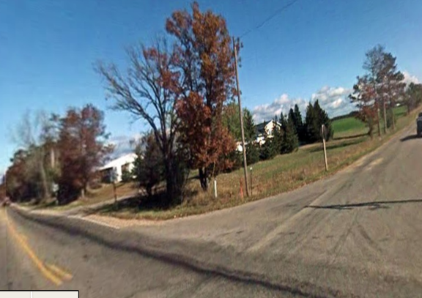

Slide 20
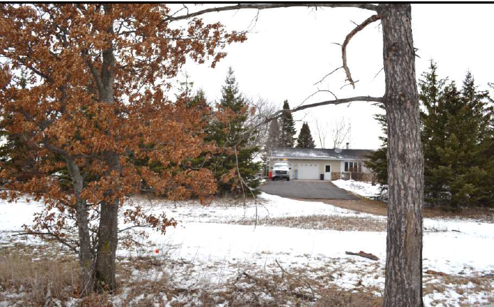

Slide 21
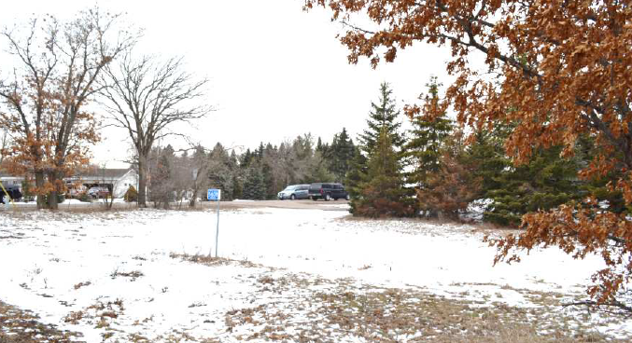

Slide 22
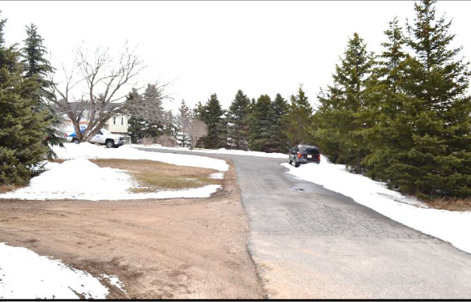

Slide 23
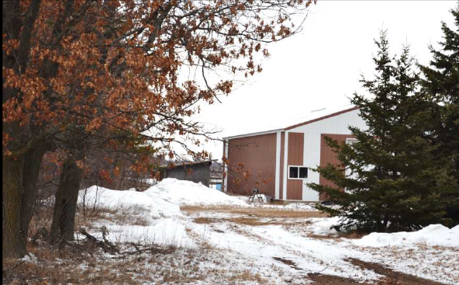

Slide 24
Project Impact
Set back from County Highway indicated 108 feet to 42 feet.
Property was conforming to setback requirements in the after condition.
Loss of land (1.12 acres), outbuildings, and landscaping.

Slide 25
Sales
Three sales from three markets:
Moderate-income Market
Middle-income Market
High-income Market

Slide 26
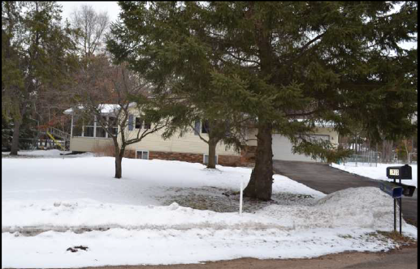
Comp. Improved #5

Slide 27
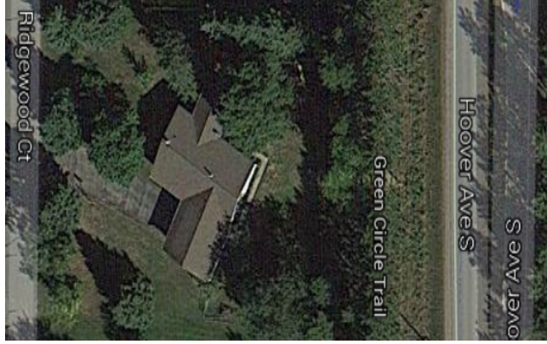
Aerial # 5

Slide 28
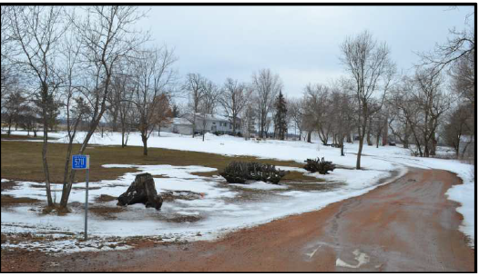
Comp. Improved # 14

Slide 29
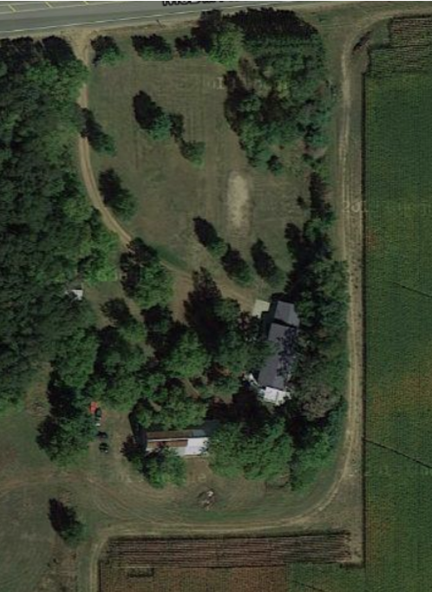
Aerial # 14

Slide 30
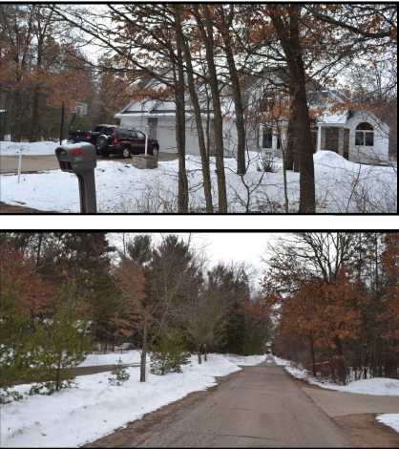
Comp. Improved #3

Slide 31
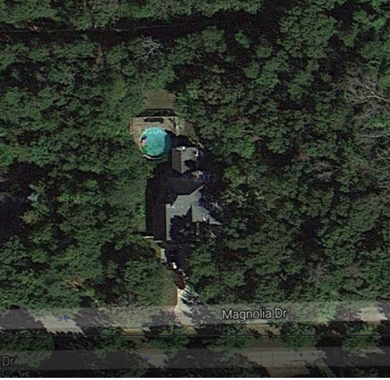
Aerial # 3

Slide 32
Damages Determination
Adjustments were made to the comparable sales to determine the before value of the subject.
The range of diminution in the markets due to proximity indicates a potential loss of 6% to 33%.
The subject was determined to be between a Middle-income range and High-income range property in the before condition (closer to Middle) and reduced to a Moderate-income range property in the after condition.

Slide 33
Range of Damage due to Proximity
Adjusting for physical attributes and adding in the value of the land as vacant created the following range in values for the subject:
Moderate-income adjusted to the subject = $195,400
Middle-income adjusted to the subject = $207,500
High-income adjusted to the subject = $294,500
Appraiser determined $220,000 Before Value

Slide 34
Damages
The appraiser determined a Before value = $220,000
Loss due to the take = Landscaping, land, outbuildings totaled $39,200.
Loss due to Proximity = 15% = $33,000
After Value = $147,800
Total Loss in market value estimate = $72,200

Slide 35
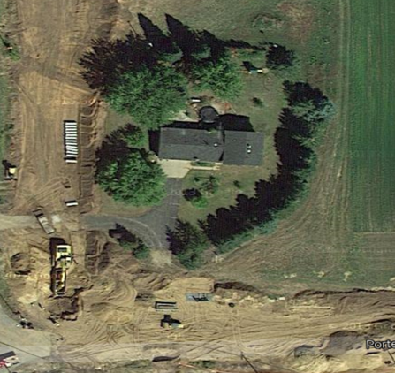
Subject After

Slide 36
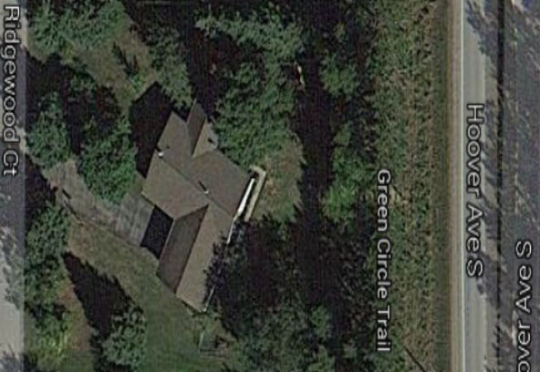
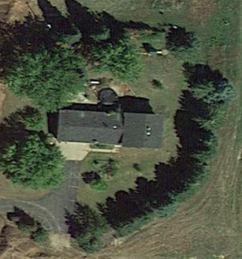
After Condition Comparison
The subject falls into this market….
However, the added acreage increases its value toward the middle range.

Slide 37
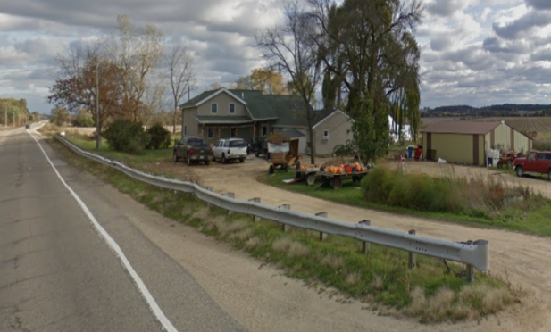
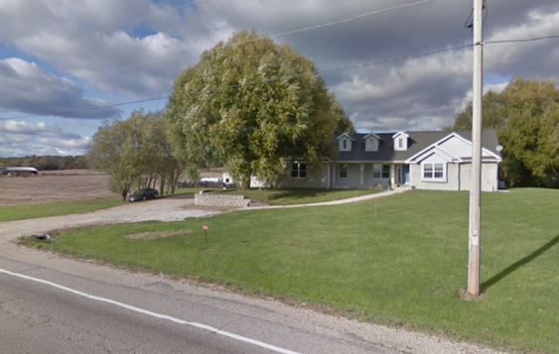
Illustration of Market Segmentation
Affordability Segmentation
Market 1
Market 2

Slide 38
Considerations
Doesn’t always work, more study or consideration must given to the concept of proximity within the same market. How would you do this?
Market delineation can include three or more markets. For example:
Fair, Moderate, Middle, High or some other delineation as determined by the appraiser. This is Market segmentation and requires meaningful user groups based on the property’s attributes ( and changing attributes)
Quality of construction, age, functional obsolescence can require large adjustments. Are these typically considered in the Proximity Studies?
Location vs situs analysis.
Demand characteristics categorize the buyers

Slide 39
Demand Factors
The number of buyers
The income of buyers
The price of related real estate goods and services
The appeal as measured by tastes and preferences
Market trends and property attributes have a decisive impact on value.

Slide 40
Remember
It is always the darkest just before dawn.
So that’s the time to steal your neighbor’s newspaper!

